Slide 1








AdoptaPet
TuKing

Slide 2




TuKing
Team Members
Ximena Valderrama
Sergio
Sandoval
Product owner
Development team
Web App Developer
Scrum master
Development team
Desktop App Developer

Slide 3






TuKing
Problematic
The issue addressed in this project focuses on the concerning number of abandoned animals in Chile, as well as the lack of knowledge and awareness about Responsible Pet Ownership among people when adopting a pet.

Slide 4




TuKing
Solution
The proposed solution to address this issue involves the development of a web application designed to facilitate pet adoption and the search for lost animals. The platform will also include an educational section dedicated to promoting responsible pet ownership. To complement this effort, a desktop application will be created to efficiently manage and administer the web application.

Slide 5



TuKing
Objective
Main Objective
To find families for abandoned pets, minimize abandonment, and promote better care for pets.
Specific Objectives
Implement a registration system for pets available for adoption, as well as for lost and found pets.
If the pet has a medical record, upload it for more detailed information.
Provide relevant information on animal care and responsible adoption.
Ensure the scalability and maintainability of the platform for future developments and improvements.

Slide 6


TuKing
Scope
A web platform for registering and searching pets for adoption, as well as lost and found pets.
Educational resources about animal care and responsible ownership.
Nationwide coverage in Chile, promoting responsible adoption.
Scalable development using Agile Scrum methodology.

Slide 7
TuKing
Limitations
Technical complexity in development and integration.
Dependency on team collaboration and communication.
Limited time for development and testing.

Slide 8

TuKing
Scrum Methodology
The Scrum methodology was used for the development of the project as it is highly flexible in the face of changes, allowing for rapid adaptation to new requirements or adjustments during the process.
Effective work
Incremental delivery (Sprints)
Greater project control
Early feedback

Slide 9

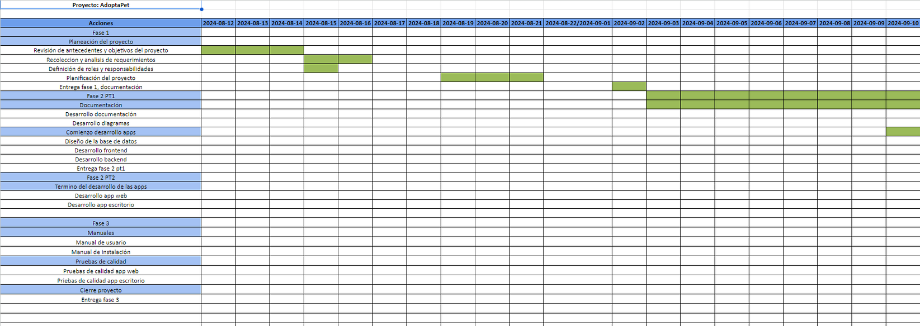
TuKing
Timeline

Slide 10


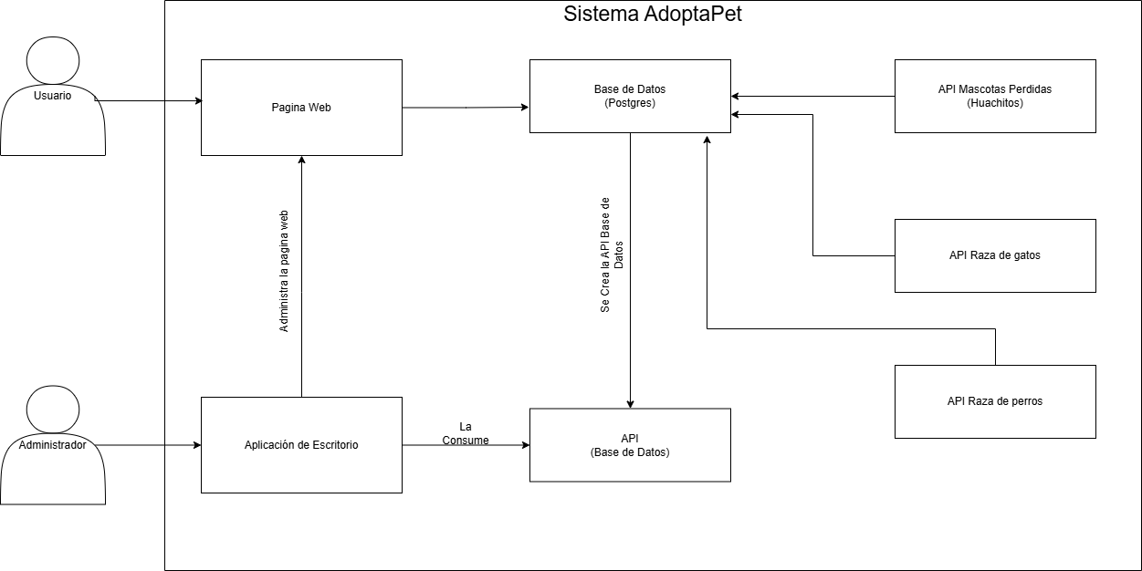


TuKing
Architecture

Slide 11
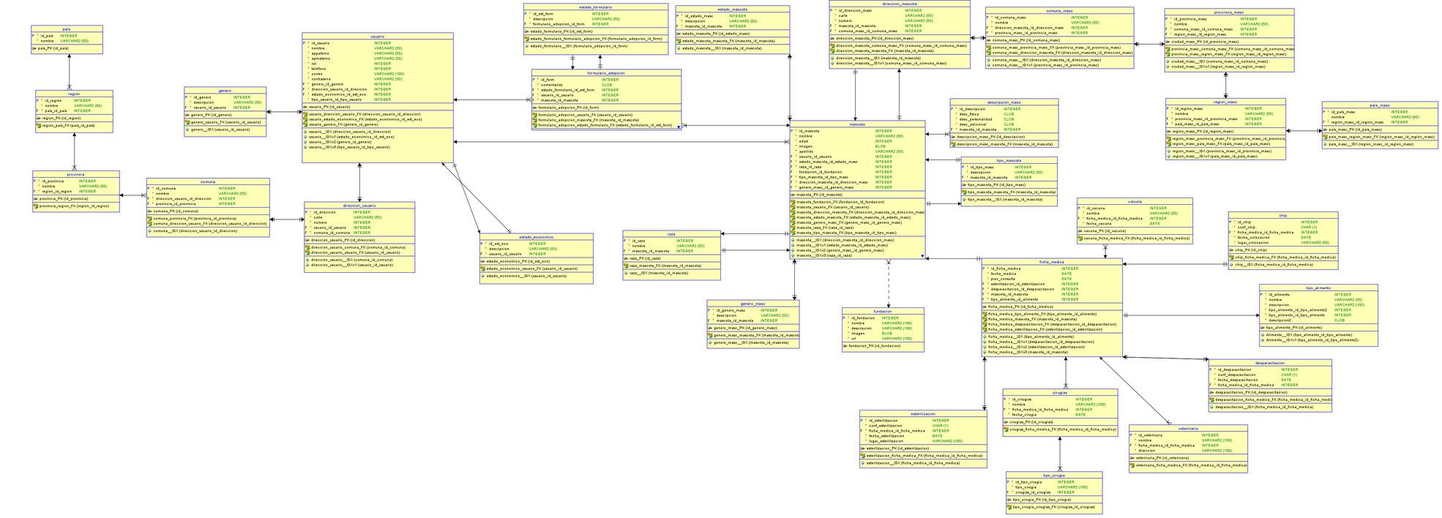
TuKing
Data Model

Slide 12
TuKing
Technologies Used
Web App Technologies
Backend
Python
Django
Frontend
CSS
HTML
JavaScript
APIs
Database API - Django REST Framework Framework
Integrated APIs:
Cat breeds
Dog breeds
"Huachitos" (Foundations)
Development Environment:
VIsual Studio Code

Slide 13
TuKing
Technologies Used
Desktop App Technologies
Java
Development Environment
Netbeans

Slide 14
TuKing
App Demonstration

Slide 15
TuKing
Quality Testing

Slide 16
TuKing
Obstacles
Poor Communication
Poor communication at the beginning of the project.
Mismanaged Time
Short development or meeting times.
Technical Complexity
Using a different database required learning new things.

Slide 17


TuKing
Thank You for Your Attention

